Slide 1
Distance Time Graphs
Physics

Slide 2
Lesson Objective
By the end of the lesson you will be able to describe and graph:
Distance–time graphs

Slide 3
Review
Think Pair Share
How is distance different from displacement?
Is it scalar or vector?

Slide 4
Why a graph?
A graph is a useful way of illustrating an object’s motion.
Time is always placed on the horizontal axis.

Slide 5
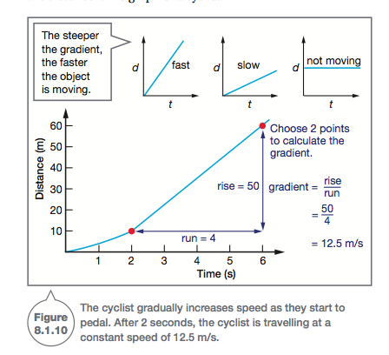
Distance–time graphs
A distance–time graph shows how far an object travels as time progresses
The gradient = speed. So, a steeper slope indicates a faster speed than a gentle slope.
Gradient =
rise/run

Slide 6
A flat line on this graph indicates that the motion has stopped.
The slope of a distance–time graph is equivalent to the object’s average speed over a time interval

Slide 7
Describe the motion of the cyclist.
Find their speed for the triangle indicated.
Notes:
Gradually increases speed. Between 2 seconds to 6 seconds, they are travelling at a constant speed of 12.5 m/s

Slide 8
Displacement–time graphs
Alternatively, an object’s displacement can be shown on the vertical axis of a graph instead of distance.
In this case, the graph shows how the position of the object changes compared to where it started.

Slide 9
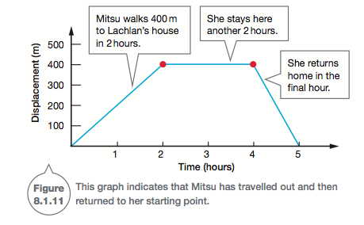

Slide 10
Recall
30 seconds think time
Describe:
Distance–time graphs

